Slide 1
What is a program?

Slide 2
A program is a set of instructions that a computer follows in order to perform a particular task.
Ex : Instructions to find the sum of two numbers.

Slide 3
What is algorithm?

Slide 4
An algorithm is a way or approach which is most often used to solve problems or perform tasks.

Slide 5
Algorithm for sum of two numbers.
STEP 1 : START
STEP 2 : ACCEPT FIRST NUMBER
STEP 3 : ACCEPT SECOND NUMBER
STEP 4 : ADD THESE TWO NUMBERS
STEP 5 : DISPLAY RESULT
STEP 6 : STOP

Slide 6
What is a programming language?

Slide 7
A programming language is a formal language, which are used to implement algorithms.

Slide 8
Python Program to find sum of two numbers.
A = 10 //A is a variable which stores 10
B = 20
Sum = A+B
Print(Sum)
// output
30

Slide 9
Features of python
1) Easy to Learn and Use
2) Interpreted Language
Python is an interpreted language i.e. interpreter executes the code line by line at a time.
This makes debugging easy and thus suitable for beginners.
3) Free and Open Source
4) Cross-platform Language
Python can run equally on different platforms such as Windows, Linux,
Unix and Macintosh etc. So, we can say that Python is a portable language.
5) Integrated
It can be easily integrated with languages like C, C++, JAVA etc.

Slide 10
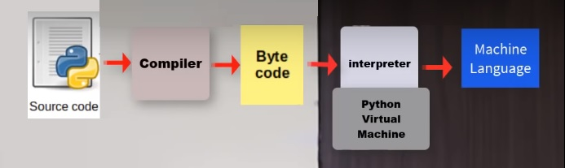
Python architecture
Since python is a very high level language that’s why whatever instructions given through it is not understood by machine . In order to make machine understand the instructions we need to convert the source code(High level language) to machine code(Low level language).
In python we have compiler which converts the source code to intermediate code(Byte code) and than this Byte code gets converted to machine code by the help of interpreter(generally pvm does it).

Slide 11
Person A
(English)
C
(English -> Hindi)
D
(Hindi-> Orria)
Person B
(Orria)

Slide 12
Python Variables
A = 10
B = 20
Sum = A+B
Print(Sum)
// output
30
Variables are containers for storing data values.
A variable is created the moment you first assign a value to it.

Slide 13
Variable Names
A variable can have a short name (like x and y) or a more descriptive name (age, carname, total_volume).
Rules for Python variables:
A variable name must start with a letter or the underscore character
A variable name cannot start with a number
A variable name can only contain alpha-numeric characters and underscores (A-z, 0-9, and _ )
Variable names are case-sensitive (age, Age and AGE are three different variables)

Slide 14
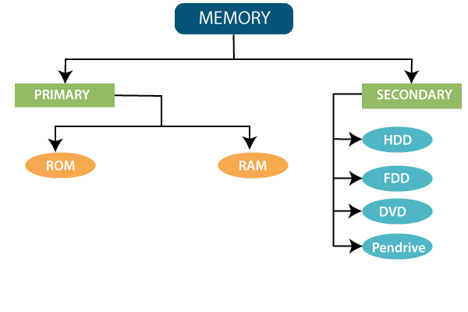

Slide 15
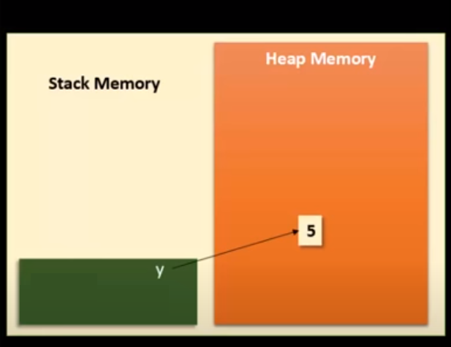
Ram
Y = 5
xxxxxa
Y holds the address not the values .whenever we try to print y by default it call the address and returns the value at that address.

Slide 16
W H AT H A P P E N S W H E N Y O U D O A = 3 , B = 3 ?
Name
Reference
3
xxxxa
A
xxxxa
Heap memory
B
xxxxa

Slide 17
W H AT H A P P E N S W H E N Y O U D O A = 3 , B = ‘abc’ ?
Heap memory
3
xxxa
xxxa
A
abc
B
xxxb
xxxb

Slide 18


W H AT H A P P E N S W H E N Y O U D O A = ‘sumit’ , B = ‘sumit’ ?
Earlier A =3
Heap memory
X
3
xxxa
A
xxxa
GARBAGE COLLECTION
xxxb
B
sumit
xxxb

Slide 19
Garbage Collection in python
The process by which Python periodically frees and reclaims blocks of memory that no longer are in use is called Garbage Collection which is done by garbage collector.

Slide 20
Python Data Types
Variables can hold values of different data types. Python is a dynamically typed language hence we need not define the type of the variable while declaring it. The interpreter implicitly binds the value with its type.
Python enables us to check the type of the variable used in the program. Python provides us the type() function which returns the type of the variable passed.

Slide 21
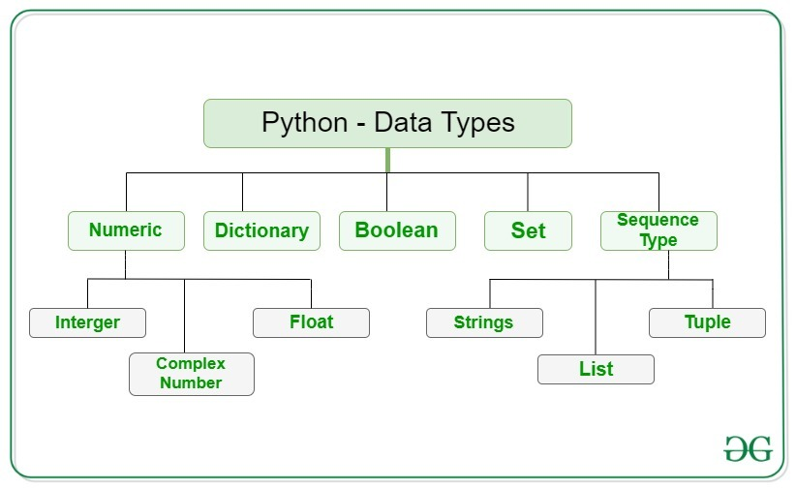

Slide 22
Integers – This value is represented by int class. It contains positive or negative whole numbers (without fraction or decimal). In Python there is no limit to how long an integer value can be.
Float – This value is represented by float class. It is a real number with floating point representation. It is specified by a decimal point. Optionally, the character e or E followed by a positive or negative integer may be appended to specify scientific notation.
# Python program to
# demonstrate numeric value
a = 8
print("Type of a: ", type(a)) #output
Type of a: <class ‘int’>
b = 8.0
print("Type of b: ", type(b)) #output
Type of b: <class ‘float’>

Slide 23
String
The string can be defined as the sequence of characters represented in the quotation marks. In python, we can use single, double, or triple quotes to define a string.
The following example illustrates the string handling in python.
str1 = 'hello learners' #string str1
str2 = 'how are you?' #string str2
str3 = ‘1' #string str3
b = 'hello'
print("Type of b: ", type(b)) #output
Type of a: <class ‘str’>

Slide 24
Python is a dynamically-typed language
java
public class AddTwoNumbers {
public static void main(String[] args) {
int num1 = 5;
int num2 = 6;
int sum;
sum = num1 + num2;
System.out.println("Sum of these numbers: "+sum);
}
}
python
a = 5
b = 6
sum = a + b
print(sum)

Slide 25
Static typed programming languages are those in which variables have to be declared before they are used. C is statically typed language.
whereas
Dynamic typed programming languages are those languages in which variables must necessarily be defined before they are used.

Slide 26
strongly typed v/s
weakly typed languages
The difference between a strongly typed language and a weakly typed language is that a strongly typed language checks the type of a variable before performing an operation on it, whereas a weakly typed language does not.

Slide 27
Python Operators
Operators are used to perform operations on variables and values.
Python divides the operators in the following groups:
Arithmetic operators
Assignment operators
Comparison operators
Logical operators
Identity operators
Membership operators
Bitwise operators

Slide 28
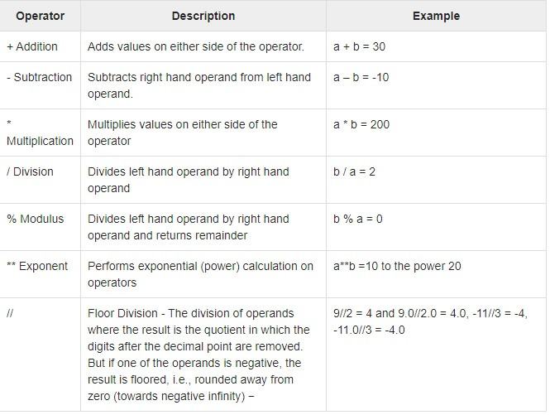
Python Arithmetic Operators
Assume variable a holds 10 and variable b holds 20, then −

Slide 29
Python programming…….
Python Program to Print Hello world!
# This program prints Hello, world!
print('Hello, world!')
Hello, world!

Slide 30
Python Program to Add Two Numbers
# This program adds two numbers
num1 = 1.5
num2 = 6.3
# Add two numbers
sum = num1 + num2
# Display the sum
print('The sum is :',sum)

Slide 31
Python Program to Calculate the Area of a Triangle
If a, b and c are three sides of a triangle. Then,
s = (a+b+c)/2
area = √(s*(s-a)*(s-b)*(s-c))
√x = x
½

Slide 32
# Python Program to find the area of triangle
a = 5
b = 6
c = 7
s = (a + b + c) / 2
area = (s*(s-a)*(s-b)*(s-c)) ** 0.5
print('The area of the triangle is‘,area)

Slide 33
Python Program to Convert Celsius To Fahrenheit
celsius * 1.8 = fahrenheit - 32

Slide 34
# Python Program to convert temperature in Celsius to Fahrenheit
# change this value for a different result
celsius = 37.5
# calculate fahrenheit
fahrenheit = (celsius * 1.8) + 32
print(fahrenheit)

Slide 35
Python print() statement
1. The end parameter
The end parameter is used to append any string at the end of the output of the print statement in python.
By default, the print method ends with a newline. This means there is no need to explicitly specify the parameter end as '\n'.
print("Hi", end=' Fbs ')
print("you are awesome")
Output:
Hi Fbs you are awesome

Slide 36
2. The sep parameter
Sometimes, we may wish to print multiple values in a Python program in a readable manner. This is when the argument sep comes to play. The arguments passed to the program can be separated by different values. The default value for sep is whitespace.
print("Study", "tonight", sep = '')
print("Study", "tonight", sep = ' & ')
Output:
Studytonight
Study & tonight

Slide 37
Python input() Function
How the input function works in Python :
When input() function executes program flow will be stopped until the user has given an input.
The text or message display on the output screen to ask a user to enter input value is optional i.e. the prompt, will be printed on the screen is optional.
Whatever you enter as input, input function convert it into a string. if you enter an integer value still input() function convert it into a string. You need to explicitly convert it into an integer in your code using typecasting.
print('Enter your name:') x = input() print(x)
Or
x = input('Enter your name:') print(x)
Converting one datatype into another is known as type casting or, type-conversion.

Slide 38
Execute and check !!
# Program to check input
# type in Python
num = input ("Enter number :")
print(num)
name1 = input("Enter name : ")
print(name1)
# Printing type of input value
print ("type of number", type(num))
print ("type of name", type(name1))

Slide 39
Multiple assignment
Ex:
x = y = z = 10
print(x)
print(y)
print(z)
Python allows us to assign a value to multiple variables in a single statement which is known as multiple assignment.
We can apply multiple assignment in two ways either by assigning a single value to multiple variable or by assigning multiple values to multiple variables.
The values will be assigned in the order in which variables appears.
Ex:
x,y,z = 10,5,2
print(x)
print(y)
print(z)

Slide 40
Decision control structure
If
If-else
If-elif-else

Slide 41
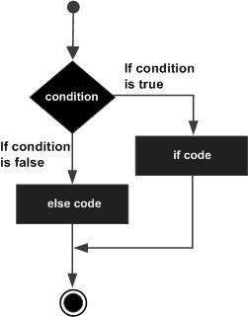
Python IF...ELIF...ELSE Statements
if expression:
statement(s)
else:
statement(s)

Slide 42
Python Program to Check if a Number is Positive or Negative
num = 10
if num >= 0:
print("Positive number")
else:
print("Negative number")
Indentation in Python refers to the (4 spaces) that are used at the beginning of a statement.

Slide 43
Elif
The elif keyword is pythons way of saying "if the previous conditions were not true, then try this condition".
Example
a = 33 b = 33 if b > a: print("b is greater than a") elif b < a: print("a is greater than b")
else: print(“both are equal")

